Slide 1
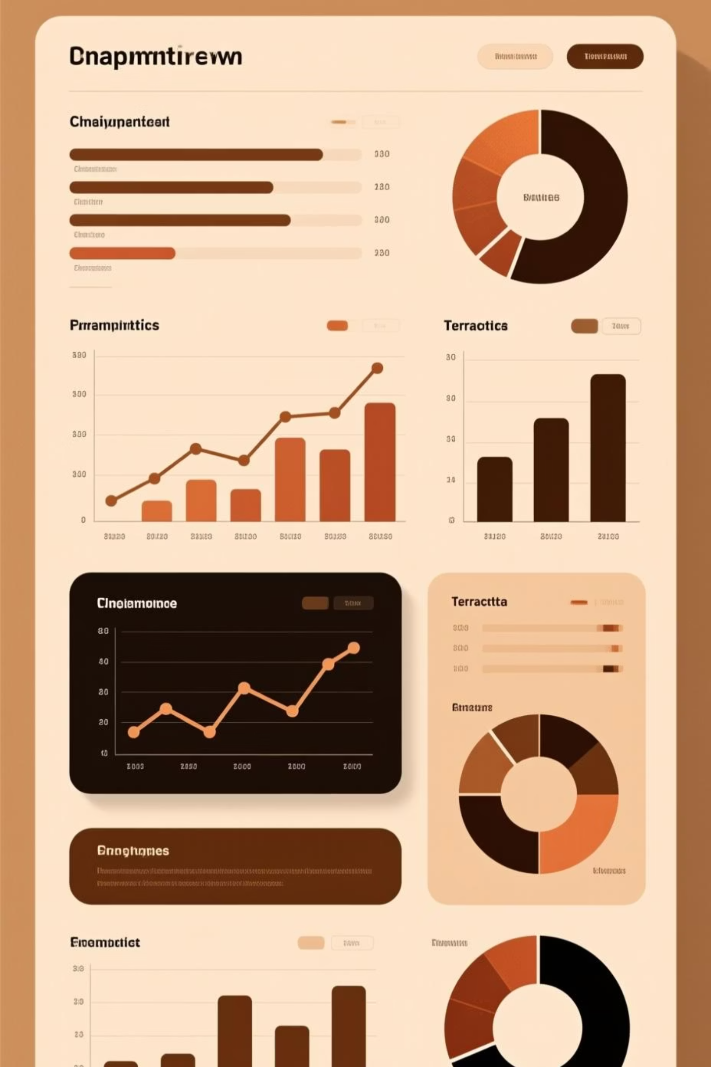

Unlock Customer Shopping Insights
Harnessing data with PostgreSQL, Jupyter Notebook (Python), & Power BI to drive impactful business strategies.
NEHA RAUT
05/01/2026

Slide 2

Unlocking Customer Behavior for Growth
Driving business intelligence and data-driven decision-making.
Empower Your Strategy with Insights
Uncover critical purchase patterns, frequency, and spending habits to empower strategic marketing, optimize product placement, and maximize revenue growth.
Our Data-Driven Approach
This project leverages PostgreSQL for robust data storage, Python for sophisticated analysis and cleaning, and Power BI for compelling, interactive visualizations.

Slide 3

The Challenge: Unlocking Customer Data
Untapped Data Streams
Uncover Hidden Patterns
Businesses are awash in raw transaction data, yet its true value often remains untapped and underutilized.
Critical questions emerge: Which products dominate sales? Which customer segments drive the most revenue?
Drive Actionable Insights
Translating data into strategy demands clarity: How do demographics and product types influence buying decisions?

Slide 4
Project Objectives
Uncover Purchase Trends
Optimize Data Management
Deep dive into real-world transaction data to reveal crucial customer purchase patterns and preferences.
Leverage PostgreSQL to build a robust, scalable foundation for storing and rapidly querying vast datasets.
Refine & Transform Data
Empower Business Insights
Utilize Python in Jupyter Notebooks to meticulously clean, process, and analyze complex raw data.
Create dynamic, interactive dashboards in Power BI to translate data into actionable business intelligence.

Slide 5

Driving Insights: Our Tech Stack
PostgreSQL
Establishes a robust data foundation, enabling efficient storage and lightning-fast queries for massive transaction records.
Jupyter Notebook
Transforms raw data into actionable insights through rigorous cleaning, exploratory analysis, and powerful statistical modeling.
Power BI
Translates complex data into dynamic, interactive dashboards and compelling visualizations, empowering strategic decisions.

Slide 6
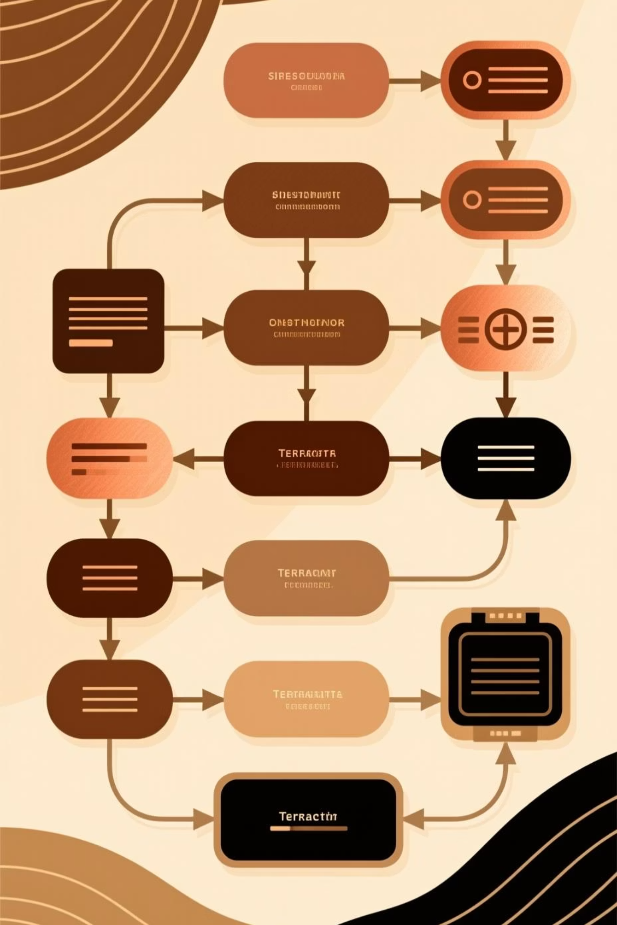
Unlocking Insights: Our Transaction Dataset
Dive into our rich dataset, meticulously structured to empower deep analysis and uncover powerful customer insights from detailed shopping transaction records:
Column Name
Description
Data Type
Customer_ID
Unique customer identifier for tracking individual behavior
Integer
Age
Age of customer, vital for demographic segmentation
Integer
Gender
Gender of customer, informing targeted marketing strategies
Varchar
Product_Category
Category of product purchased, revealing popular trends
Varchar
Quantity
Quantity of items purchased in a single transaction
Integer
Total_Amount
Total monetary value of the transaction, for revenue tracking
Numeric

Slide 7
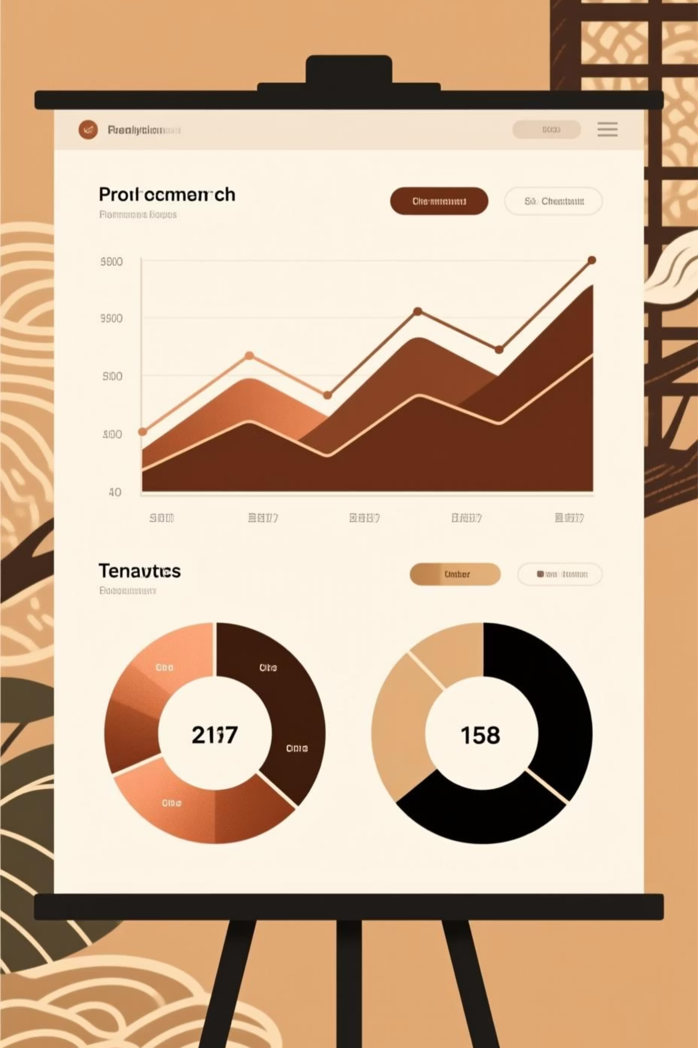





Unlocking Insights: Our Data Workflow
Collect & Ingest Data
Securely load raw datasets into PostgreSQL for robust storage.
Analyze & Explore
Execute targeted SQL queries to uncover initial trends and patterns.
Refine & Prepare
Leverage Python for advanced data cleaning and transformation.
Visualize & Report
Develop interactive Power BI dashboards for compelling data storytelling.
Key SQL Operation
Example: Discover top-selling product categories to maximize revenue potential.
SELECT product_category, SUM(total_amount) AS total_sales FROM shopping_data GROUP BY product_category ORDER BY total_sales DESC;

Slide 8

Unveiling Critical Data Insights
Top Categories Drive Revenue
Identify high-impact product categories fueling significant sales growth.
Target High-Value Demographics
Pinpoint age groups exhibiting elevated spending patterns, optimizing outreach.
Core Products Fuel Growth
Discover the vital few products generating a large portion of total revenue.
Optimize with Behavioral Patterns
Leverage clear purchasing trends to inform precise, targeted marketing strategies.

Slide 9

Data-Driven Decisions: Power BI Dashboard
Dive into a dynamic, interactive dashboard designed to reveal critical business insights through comprehensive visualizations:
Essential KPI Cards
Track performance instantly with key metrics: Total Sales & Customer Acquisition.
Strategic Category Analysis
Identify top performers and growth opportunities: Sales by Category Bar Chart.
Demographic Insights: Gender
Understand customer segments better: Sales by Gender Pie Chart.
Maximize Revenue: Top Products
Pinpoint success: Detailed table of best-selling items.

Slide 10

Driving Business Forward: Impact & Future Vision
Achieving Data-Driven Success
Strategic Roadmap: Next Frontiers
This project showcases how integrating PostgreSQL, Python, and Power BI transforms raw customer shopping data into actionable insights, fundamentally enhancing business decision-making.
Integrate location, season, and payment data
Implement machine learning for deeper customer segmentation
Forecast future sales trends with advanced predictive analytics
Develop real-time dashboard capabilities for instant insights

